Slide 1
Topics 1 to 4
Define Maternal Mortality Rate. What are the causes for maternal mortality? 3+7
Discuss the measures taken to reduce and prevent maternal mortality. 10
Discuss the magnitude of problem of cancer in India and world. 10
Discuss the risk factors, and prevention and control strategy for cervical cancer. 10

Slide 2
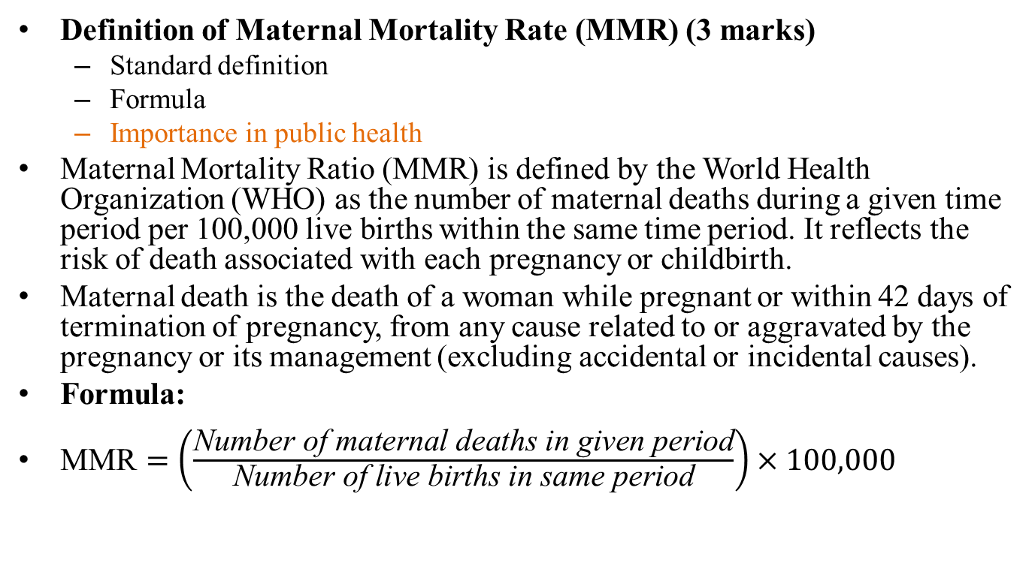
Define Maternal Mortality Rate. What are the causes for maternal mortality?
Definition of Maternal Mortality Rate (MMR) (3 marks)
Standard definition
Formula
Importance in public health
Maternal Mortality Ratio (MMR) is defined by the World Health Organization (WHO) as the number of maternal deaths during a given time period per 100,000 live births within the same time period. It reflects the risk of death associated with each pregnancy or childbirth.
Maternal death is the death of a woman while pregnant or within 42 days of termination of pregnancy, from any cause related to or aggravated by the pregnancy or its management (excluding accidental or incidental causes).
Formula:
$\text{MMR}=\left(\frac{\text{Number} \text{of} \text{maternal} \text{deaths} \text{in} \text{given} \text{period}}{\text{Number} \text{of} \text{live} \text{births} \text{in} \text{same} \text{period}}\right)×100,000$

Slide 3
Importance in public health
Indicator of Health System Performance
Guides Resource Allocation and Policy
Tracking Progress towards Global Goals
Focus on Equity
Public Awareness and Advocacy
Epidemiological Surveillance

Slide 4
Causes of maternal mortality (7 marks):
Medical causes (haemorrhage, infection, hypertension, obstructed labor, unsafe abortion)
Socioeconomic factors (poverty, poor access, malnutrition, education)
Include Three Delays Model:
Delay in seeking care
Delay in reaching care
Delay in receiving appropriate care

Slide 5
Period | Common Causes of Maternal Mortality
Antenatal Period (ANC) | - Ectopic pregnancy rupture (early first trimester)
 | - Severe anemia
 | - Hypertensive disorders (pre-eclampsia, eclampsia) (2nd and 3rd trimester)
 | - Infections/sepsis
 | - Unsafe abortion complications (first trimester)
Natal Period (Labor & Delivery) | - Postpartum hemorrhage (PPH)
 | - Obstructed labor
 | - Uterine rupture
 | - Sepsis/infections
 | - Complications of cesarean section
Postnatal Period (PNC) | - Postpartum hemorrhage (within 24 hours)
 | - Sepsis (puerperal)
 | - Thromboembolism
 | - Hypertensive complications
 | - Delayed or inadequate postpartum care

Slide 6
Delay / Pregnancy Period | Antenatal Period (ANC) | Natal Period (Labor & Delivery) | Postnatal Period (PNC)
Delay 1: Decision to Seek Care | Lack of awareness of danger signs; cultural beliefs; financial constraints | Delay in recognizing labor complications; choosing place of delivery | Ignorance of postpartum danger signs; traditional practices
Delay 2: Delay in Reaching Care | Transportation barriers; distance to facility | Lack of transport during labor emergencies | Accessibility to postnatal care centers
Delay 3: Delay in Receiving Adequate Care | Inadequate ANC services; poor staff training | Inadequate skilled birth attendance; lack of EmOC | Poor postnatal follow-up; insufficient monitoring

Slide 7
Discuss the measures taken to reduce and prevent maternal mortality. (10 marks)
Introduction to maternal mortality prevention
Measures addressing the Three Delays:
Community education and early recognition (Delay in seeking care)
Emergency transportation, better roads, referral systems (Delay in reaching care)
Improving facility quality, staff training, equipment, supplies (Delay in receiving care)
Safe delivery and antenatal care
Family planning and postnatal care
Role of government schemes and frontline workers (ASHAs, ANMs, etc.)
Health system strengthening and policy interventions

Slide 8
Antenatal Care (ANC):
Early pregnancy booking and registration
At least 4 ANC visits for monitoring
Identification and management of high-risk pregnancies, nutrition, supplementation (iron, folic acid)
Screening and treatment of infections, blood pressure monitoring
Health education about danger signs
Natal Care (Intrapartum):
Skilled birth attendance (SBA) at delivery
Availability of emergency obstetric care (EmOC)
Use of oxytocics to prevent postpartum hemorrhage
Safe delivery practices and hygiene
Immediate newborn care
Postnatal Care (PNC):
Early postnatal checkup within 24-48 hours
Monitoring for postpartum hemorrhage, sepsis, eclampsia
Counseling on breastfeeding, nutrition, family planning
Identification and referral of complications
Addressing Three Delays:
Community awareness and education (seeking care)
Transport systems and referral networks (reaching care)
Improving health facility readiness, staff training, supplies (receiving care)
Program and Policy Measures:
Role of government schemes (Janani Suraksha Yojana, National Health Mission)
Involvement of frontline workers (ASHA, ANM) in maternal health services

Slide 9
Magnitude of the Problem of Cancer in India and the World (10 marks)
1. Global Cancer Burden
Estimated 20 million new cancer cases worldwide in 2022, projected to rise to 32.6 million by 2045.
Cancer is a leading cause of morbidity and mortality globally, causing approx. 10 million deaths per year.
Common global cancers: Lung, colorectal, breast, prostate, cervical, stomach.
2. Cancer Burden in India
Estimated 1.46 million new cancer cases in India in 2022; projected to increase to about 1.57 million by 2025.
Lifetime risk of developing cancer about 1 in 9 people in India.
Most common cancers: Lung (males), breast (females), oral cavity, cervix.
Incidence and mortality rates vary across regions with higher rates in urban areas and specific states.
High proportion of late-stage diagnosis due to poor awareness and limited screening.
Economic burden: Productivity loss, premature mortality, estimated billions of USD impact on GDP.

Slide 10
Cancer registries
Accurate Data Collection for Measuring Cancer Burden
Identification of Trends and High-Risk Populations
Informing Public Health Policies and Targeted Interventions
Strengths of Cancer Registries in India
Systematic Data Collection
Crucial Data for Planning and Research
Trend Analysis Capability
Support for National Cancer Control Program
Regional Focus
Challenges and Limitations of Cancer Registries in India
Limited Population Coverage
Data Quality Issues
Infrastructural and Resource Constraints
Delayed Data Reporting
Lack of Integration with Other Health Systems
Awareness and Reporting Barriers

Slide 11
Discuss the risk factors, and prevention and control strategy for cervical cancer. (10 marks)
Risk factors: HPV infection, sexual behavior, smoking, immune status, poverty
Prevention and control strategies:
Vaccination: HPV vaccine candidates, schedule, target groups
Early screening: Pap smear, VIA, age groups, frequency
Health education and awareness
Safe sexual practices and hygiene
Role of frontline workers: Outreach, education, community screening, referral
Government programs and integration with other health services

Slide 12
1. a) Define the following types of plots used in epidemiological studies and give one example of when each would be most appropriate: (5 marks)
Histogram
Scatter plot
Line graph
Pie chart
Box plot
b) Explain the concept of "epidemic curve" (epi-curve) in outbreak investigations. What are the three main patterns of epidemic curves and what does each pattern suggest about the mode of disease transmission? (3 marks)
c) A health researcher wants to display the following data visually:
Comparison of vaccination coverage rates across 5 different districts
Trend of malaria cases over 12 months in a community
Distribution of BMI values in a population sample
For each scenario, recommend the most suitable type of plot and justify your choice. (2 marks)

Slide 13
2. a) Define "Test of Significance" and explain why it is important in epidemiological research. (3 marks)
b) List any four common tests of significance used in community medicine and classify them based on the type of data they analyze (qualitative or quantitative). (4 marks)
c) For two of the tests you listed, mention a community medicine scenario where each would be appropriately used. (3 marks)
3. Discuss iceberg phenomenon and explain Hypertension as lifestyle disorder. Add a note on stroke. (3+5+2)

Slide 14
4. a) Define herd immunity and explain the principle behind it. (3 marks)
b) Describe how herd immunity is achieved in a population. (3 marks)
c) Discuss the importance of herd immunity in controlling infectious diseases with suitable examples. (2 marks)
d) Explain challenges and limitations associated with achieving herd immunity through natural infection or vaccination. (2 marks)
5. a) Define Disability-Adjusted Life Year (DALY) and explain its components. (4 marks)
b) Describe the significance of DALY as a health indicator in epidemiology and public health. (3 marks)
c) Explain how DALY can be used to prioritize health interventions in a community with an example. (3 marks)

Slide 15
Topics 7 to 12
What is the scope of Employees state Insurance (ESI) act and discuss the benefits available under this act. 10
Tests of Significance. 10
Define WHO definition of health. What are the dimensions of health and discuss the concept of well being.
Health Planning cycle
- Retrospective study Vs prospective study.
- Sentinel Surveillance
- Disability-Adjusted Life Year (DALY)

Slide 16
Topics 13 to 16
- Define Health. Describe the various indicators of health. Mention their uses.
- Define 'cause' of a disease. Enlist models of causation and describe the health belief model.
- Enumerate Sustainable Development Goals (SDGs). Discuss the indicators under Goal 3.
- Differentiate between Ujjawala Scheme, Ujjwala Yojana, and UJALA Scheme in terms of objective and target group.
Describe briefly the National AIDS Control Programme in India.

Slide 17
a) Define "Test of Significance" and explain its importance in epidemiological research. State the steps involved in conducting any test of significance. (3 marks)
b) Differentiate between the following with examples relevant to community medicine: (4 marks)
Null hypothesis (H₀) and Alternative hypothesis (H₁)
Type I error and Type II error
One-tailed test and Two-tailed test
p-value and significance level (α)
c) Classify tests of significance into Parametric and Non-parametric tests. For each category: (3 marks)
List two examples of tests
State when each category is used (mention the type of data and distribution)
Give one clinical scenario from community medicine where each category would be appropriate

